Slide 1
AMAZON LOGISTICS
A Medallion Data Warehouse Implementation"

Slide 2
PROJECT OVERVIEW :
This project focuses on the architectural design and implementation of a centralized Data Warehouse. The goal was to address fragmented data by integrating 13+ critical logistics domains—ranging from fuel consumption and maintenance to driver safety—into a single, high-performance analytical environment.

Slide 3
KEY OBJECTIVES :
Centralization: Consolidate data from external sources (Kaggle) and internal project folders.
Centralisation: Consolidate data from external sources (Kaggle) and internal project folders.
Data Integrity: Establish a clear lineage from raw ingestion to business-ready reporting.
Scalability: Implement a Medallion Architecture (Bronze, Silver, Gold) to allow for future data growth.
Actionable Intelligence: Provide tailored access for Executives (Power BI),
Operations (Excel), and Analysts (SQL).

Slide 4
TECHNICAL STACK & TOOLS:
Architecture: Medallion (3-Layer) Framework.
Modelling: Star Schema, Normalisation, Aggregated Tables.
ETL Strategy: Full Load (Truncate & Insert) & Automated Refinement.
Reporting: Power BI Embedded, Excel Dashboards.

Slide 5
High-Level Medallion Architecture
Streamlining Amazon Logistics Data Transformation Layers

Slide 6
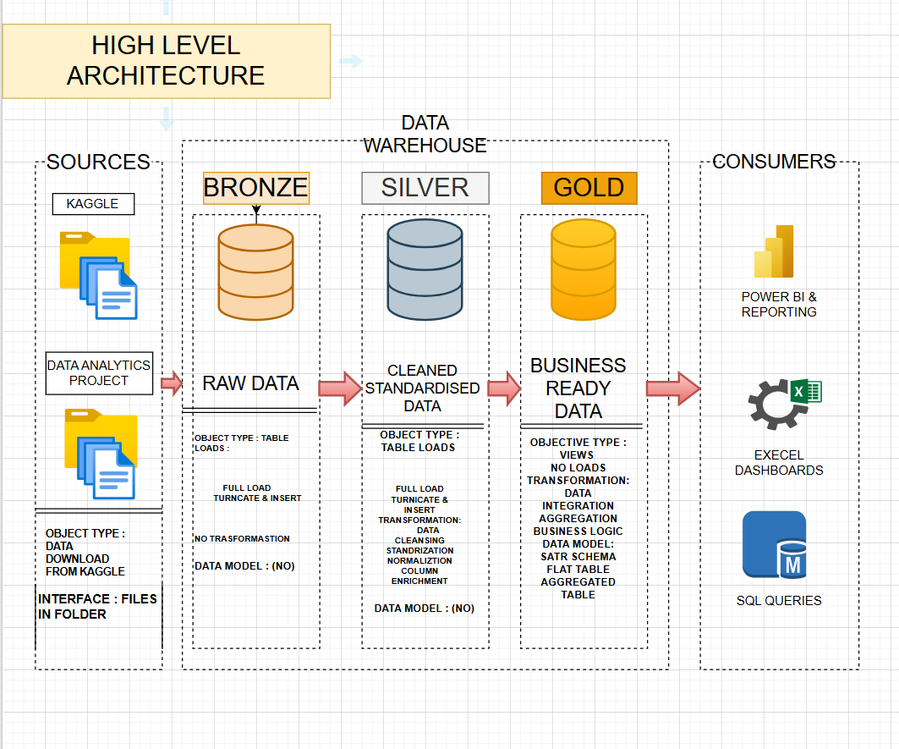

Slide 7
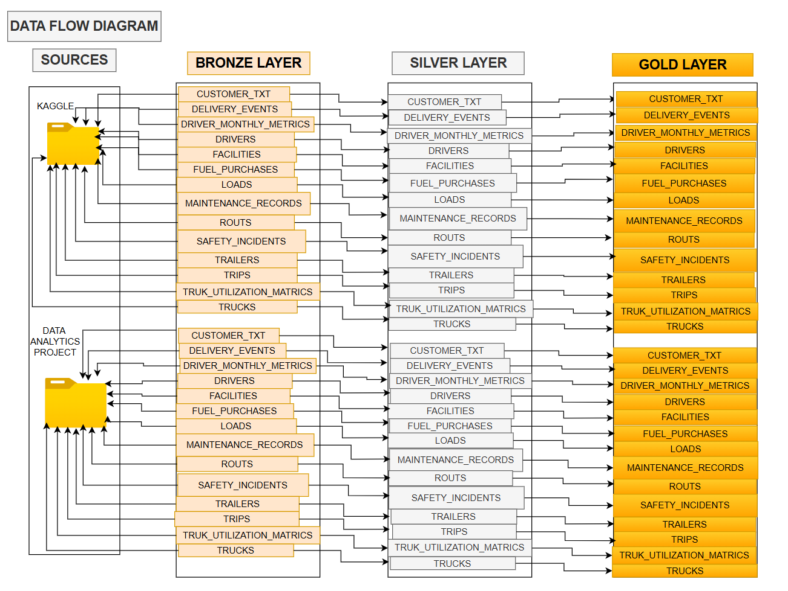

Slide 8
BRONZE LAYER: The Landing Zone (Raw Data)
Process: Ingesting raw Amazon Logistics files via Full Load (Truncate & Insert).
Data Sources: CSV/Excel files including DELIVERY_EVENTS, TRUCK_UTILIZATION, and FUEL_PURCHASES.
Key Logic: No transformations;
1:1 copy of source data to ensure a permanent historical record and easy reprocessing.

Slide 9
SILVER LAYER: The Refinement Zone (Cleaned & Standardisation)
Process: Applying schema enforcement and data quality rules.
Actions: * Data Cleansing: Handling missing delivery timestamps or null values.
Standardisation: Converting currencies and distance units (Miles vs. Kilometres).
Normalisation: Organising driver, trailer, and route data into relational formats.
Goal: Creating a "Single Source of Truth" for all logistics operations.

Slide 10
GOLD LAYER: The Analytical Zone (Business Ready)
Process: Implementing advanced data modelling for end-user performance.
Modelling: Star Schema design with centralised Fact tables (e.g., FACT_DELIVERIES) and descriptive Dimension tables.
Aggregations: Pre-calculated KPIs like Average Cost per Delivery,
Driver Safety Score, and Idle Time Ratios.
Goal: Powering high-speed queries for Power BI and SQL analysts.

Slide 11
Data Scope & Domains
Centralising 13+ Strategic Business Entities for End-to-End Visibility

Slide 12
Fleet & Asset Management
TRUCKS & TRAILERS:
Core master data for Amazon's physical delivery assets.
MAINTENANCE_RECORDS:
Service history and repair logs to monitor vehicle health.
FUEL_PURCHASES:
Tracking energy consumption and operational costs.
TRUK_UTILIZATION_MATRICS:
Load factors and efficiency KPIs for every vehicle.

Slide 13
Delivery & Routing Operations
DELIVERY_EVENTS:
Granular tracking of all package lifecycle milestones.
ROUTS & TRIPS:
Detailed mapping of delivery journeys and last-mile optimisation.
LOADS: Management of freight and cargo data across the network.
FACILITIES: Warehouse and sorting centre location metadata.

Slide 14
Human Capital & Compliance
DRIVERS:
Master records for all personnel and delivery partners.
DRIVER_MONTHLY_METRICS:
Aggregated performance scoring and efficiency KPIs.
SAFETY_INCIDENTS:
Critical logs for risk management
and safety compliance monitoring.
CUSTOMER_TXT:
Delivery destination data and customer service requirements.

Slide 15
INTEGRATION MODEL

Slide 16
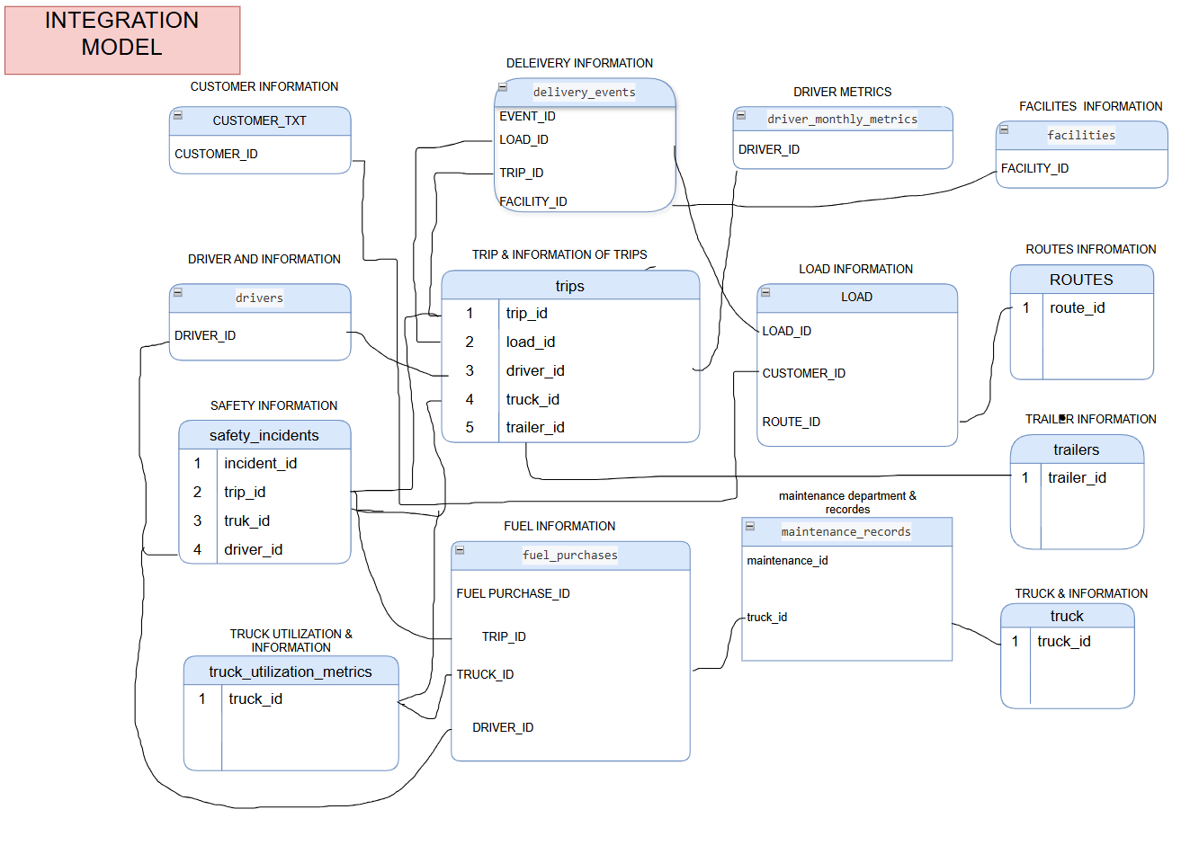

Slide 17
ENTITY RELATIONSHIP BLUEPRINT

Slide 18
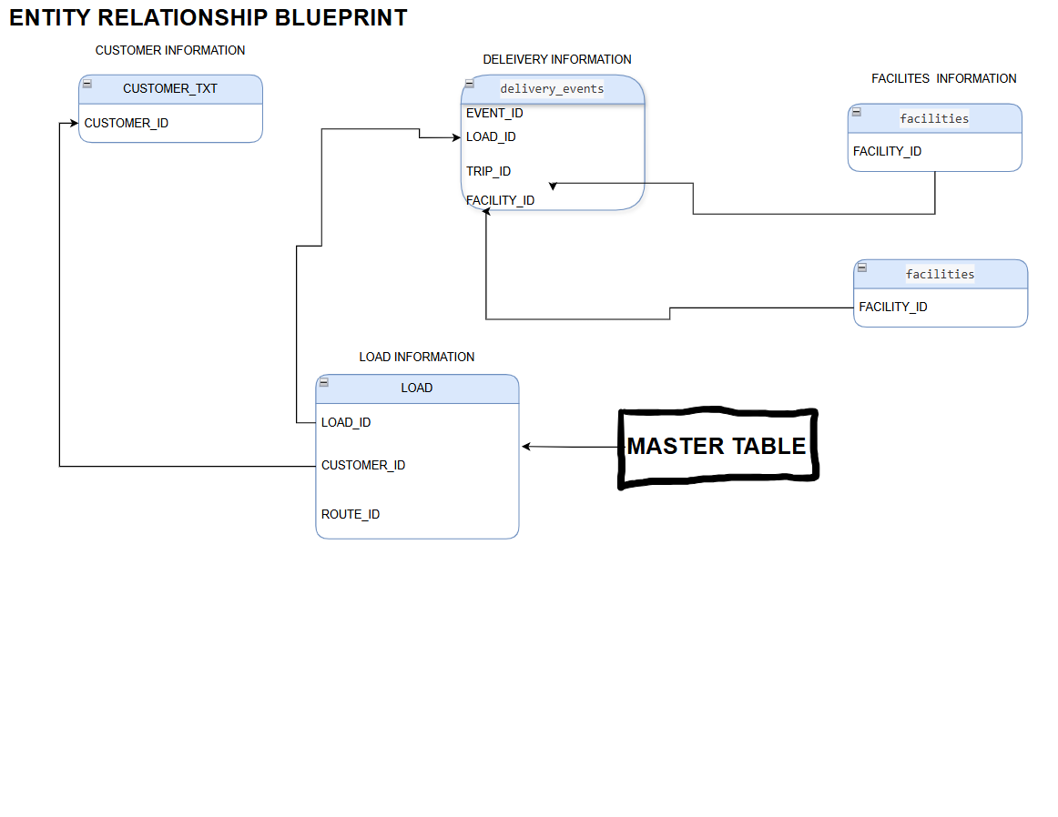

Slide 19
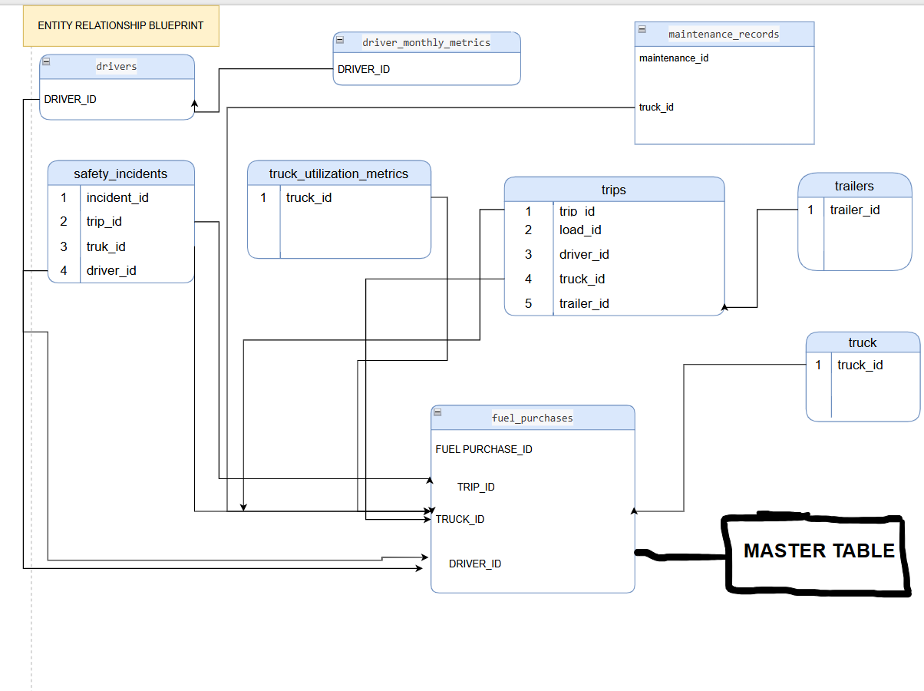

Slide 20
Data Modelling Strategy
Star Schema Implementation:
Designed a central Fact Table (e.g., FACT_LOGISTICS) connected to descriptive
Dimension Tables (Drivers, Trucks, Facilities).
Normalisation to Aggregation:
Converted the normalisation Silver data into
"Flat Tables" to reduce join complexity for Power BI users.
Data Integration:
Successfully merged disparate records (e.g., joining FUEL_PURCHASES with TRIPS via
Vehicle ID) to calculate true operational costs.

Slide 21
Key SQL Aggregations & Metrics
Fleet Efficiency:
Pre-calculated Truck_Utilization_Rate (Load Volume / Capacity)
Cost Analysis: Cost_per_Mile metrics by aggregating Fuel and
Maintenance spend.
Safety Scoring:
Weighted Safety_Incident_Ratio based on
total miles driven per driver.

Slide 22
INSIGHTS

Slide 23
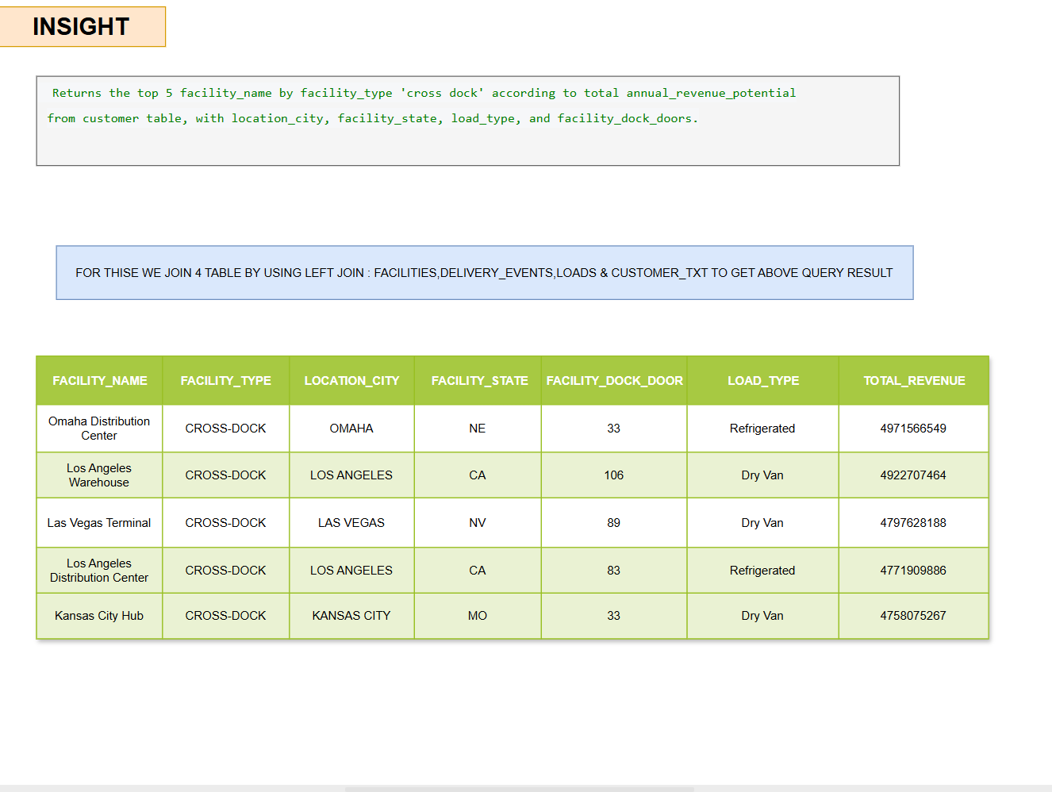

Slide 24
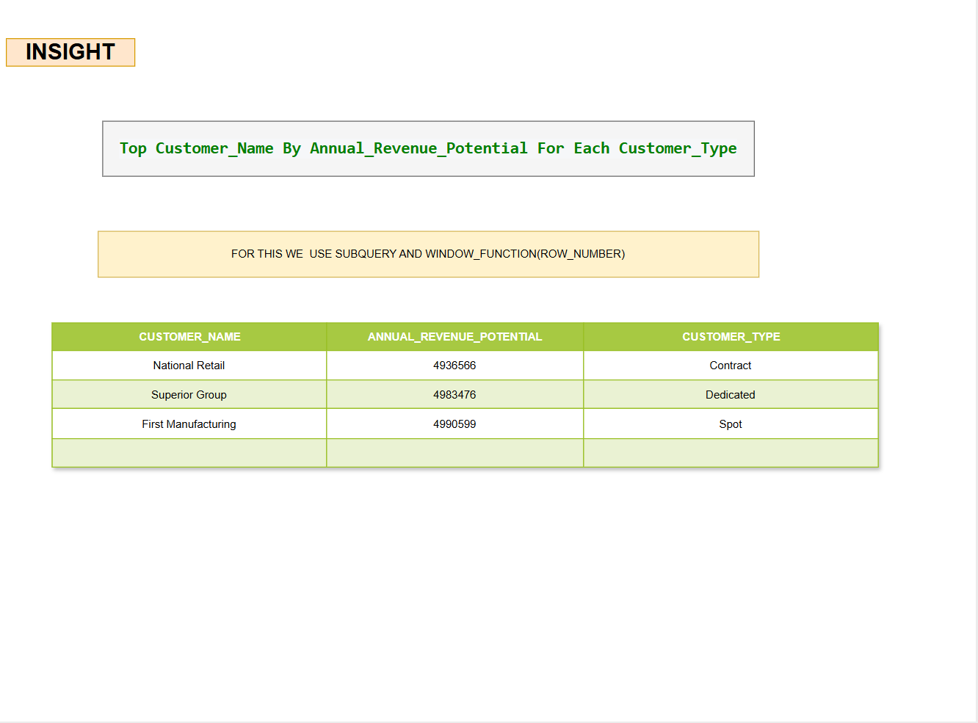

Slide 25
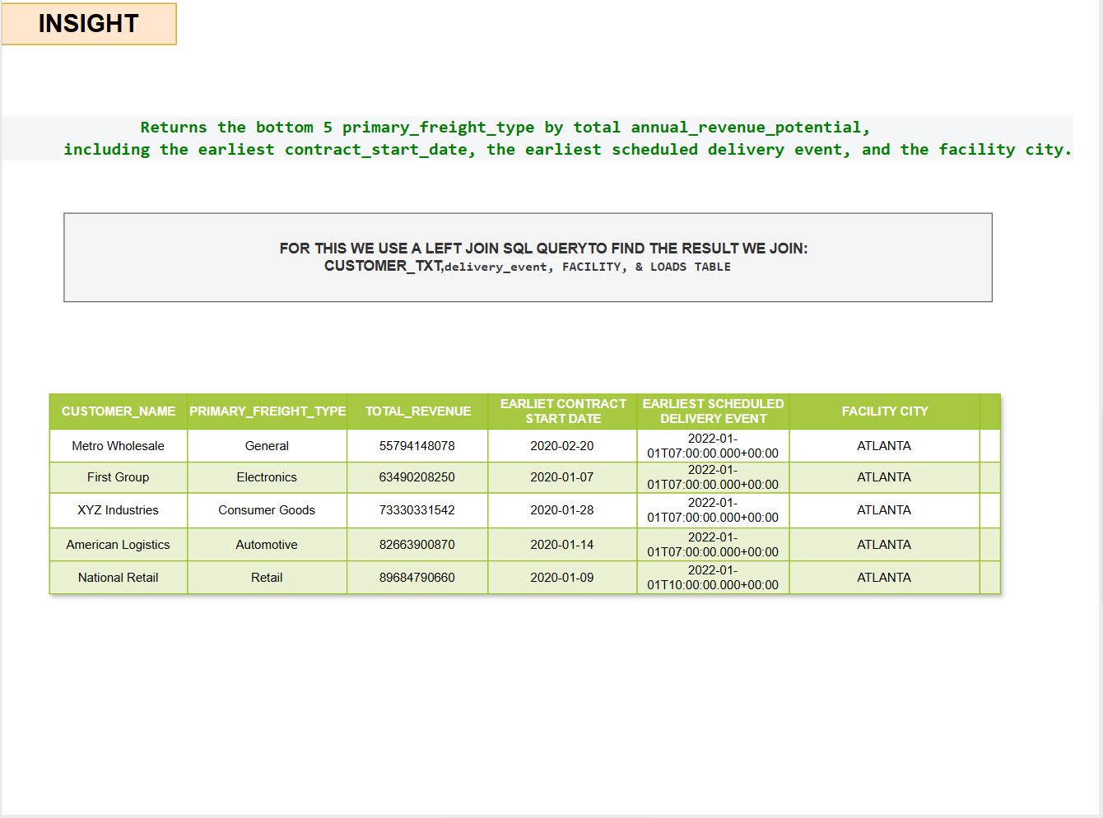

Slide 26
INSIGHTS
Returns the top 5 delivery events by location city according to total annual_revenue_potential from the customer table
WE USE LEFT JOIN. WITH THE HELP OF IT WE JOIN: LOAD & CUSTOMER TABLE
LOCATION CITY | EVENT TYPE | TOTAL REVENUE
LOS ANGELES | DELIVERY | 23766902336
KANSAS CITY | PICKUP | 23301021065
COLUMBUS | PICKUP | 20288388924
PORTLAND | DELIVERY | 19617745705
SEATTLE | DELIVERY | 19475227025

Slide 27
INSIGHTS
Returns the top 5 Customer Complaints and vehicle_damage_cost with description by using CTE
INCIDENT TYPE | VEHICLE DAMAGE COST | DESCRIPTION
Customer Complaint | 24302.3 | Minor Incident Involving Traffic
Customer Complaint | 24239.7 | Minor Incident Involving Weather
Customer Complaint | 24060.7 | Moderate Incident Involving Weather
Customer Complaint | 22667.7 | Severe Incident Involving Traffic
Customer Complaint | 22283.2 | Moderate Incident Involving Traffic

Slide 28
Actionable Insights

Slide 29
IDENTIFIED RESOURCE IMBALANCE
DISCOVERED THAT THE LOS ANELES WAREHOUSE UTILISED 106 DOCK DOORS FOR DRY VAN LOADS TO GENERATE APPROXIMATELY 4.9BILLION REVENUE. IN CONTRAST THE KANSAS CITY HUB GENERATED A NEARLY IDENTICAL 4.7 BILLION IN REVENUE USING ONLY 33 DOCK DOORS
BUSINESS RECOMMENDATION :
SUGGESTED A STRATEGIC SHIFT OF 20-25 FACILITY DOCK DOORS FROM UNDERPERFORMING LOCATIONS TO HIGH-EFFICIENCY HUBS TO BALANCE CAPACITY AND REDUCE OVERHEAD COSTS

Slide 30
HIGH-VALUE CUSTOMER TARGETS
First Manufacturing: PRIMARY LEAD
Superior Group : SECONDARY LEAD
National Retail : STRATEGIC PARTNER
Strategic Recommendations :
Targeted Incentives: Deploy volume-based discounts for FIRST MANUFACTURING to secure a long-term logistics contract.
Service Level Optimisation: Assign a dedicated "Last-Mile" priority to SUPERIOR GROUP to capture the high-margin expedited shipping market.
Operational Alignment: Align Facility schedules with NATIONAL RETAIL’s bulk pickup times to reduce truck idle time and fuel waste.

Slide 31
Identifying Optimisation Targets in Underperforming Freight Categories
PRIMARY_FREIGHT_TYPE REVENUE
General 55794148078
Electronics 63490208250
Consumer Goods 73330331542
Automotive 82663900870
Retail 89684790660
Strategic Recommendations (The "Action")
Contract Renegotiation: Review the Earliest Contract Start Dates; legacy contracts may no longer cover current fuel and maintenance costs.
Asset Reallocation: Move fleet capacity away from these low-revenue freight types in [Facility City] to higher-margin opportunities identified in the Top 5 analysis.
Operational Audit: Investigate why the Earliest Scheduled Delivery events for these types are yielding low revenue—check for high "Empty Mile" ratios or low truck utilization.

Slide 32


